Slide 1

Analysis of Algorithms
Presented by:
Elizer Ponio Jr.
Department of Computer Science
College of Computing and Information Technologies

Slide 2
Outline
What is an Algorithm?
Problems solved by Algorithms
Algorithms and Hardware
Efficiency

Slide 3
What is an Algorithm?
An algorithm is any well-defined computational procedure that takes some value, or set of values, as input and produces some value, or set of values, as output.
An algorithm is thus a sequence of computational steps that transform the input into the output.

Slide 4


What is an Algorithm?
An algorithm is said to be correct if, for every input instance, it halts with the correct output.
We say that a correct algorithm solves the given computational problem.
An incorrect algorithm might not halt at all on some input instances, or it might halt with an incorrect answer.
Contrary to what you might expect, incorrect algorithms can sometimes be useful, if we can control their error rate.

Slide 5

Problems solved by Algorithms
The Internet enables people all around the world to quickly access and retrieve large amounts of information.
With the aid of clever algorithms, sites on the Internet can manage and manipulate this large volume of data.
Example include a search engine to quickly find pages on which particular information resides.

Slide 6

Problems solved by Algorithms
Electronic commerce enables goods and services to be negotiated and exchanged electronically, and it depends on the privacy of personal information such as credit card numbers, passwords, and bank statements.
The core technologies used in electronic commerce include public-key cryptography and digital signatures, which are based on numerical algorithms and number theory.

Slide 7

Problems solved by Algorithms
A political candidate may want to determine where to spend money buying campaign advertising in order to maximize the chances of winning an election.

Slide 8

Problems solved by Algorithms
An airline may wish to assign crews to flights in the least expensive way possible, making sure that each flight is covered and that government regulations regarding crew scheduling are met.

Slide 9
Problems solved by Algorithms
Each problem may have many candidate solutions, the overwhelming majority of which do not solve the problem at hand.
Finding one that does or one that is best can present quite a challenge
There are some problems, however, for which no efficient solution is known. These subset of problems are known as NP-complete.

Slide 10


Algorithms and Hardware
Suppose computers were infinitely fast and computer memory was free.
Would you have any reason to study algorithms?
The answer is YES, if for no other reason than that you would still like to demonstrate that your solution method terminates and does so with the correct answer.

Slide 11
Algorithms and Hardware
If computers were infinitely fast, any correct method for solving a problem would do
You would probably want your implementation to be within the bounds of good software engineering practice (for example, your implementation should be well designed and documented).
But you would most often use whichever method was the easiest to implement.

Slide 12

Algorithms and Hardware
Of course, computers may be fast, but they are not infinitely fast.
Memory may be inexpensive, but it is not free.
Computing time is therefore a bounded resource, and so is space in memory.
You should use these resources wisely, and algorithms that are efficient in terms of time or space will help you do so.

Slide 13

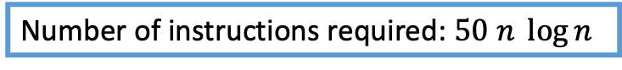
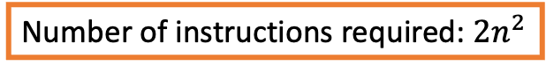
Efficiency
Example scenario: Suppose that two programmers must sort an array of 10 million numbers using two different computers A and B
Computer A
Computer B
Can execute 10 billion instructions per second
Can execute 10 million instructions per second
Programmer 1 used insertion sort
Programmer 2 used merge sort
Number of instructions required: ${2n}^{2}$
Number of instructions required: $50 n \log{n}$

Slide 14
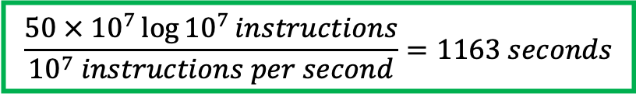
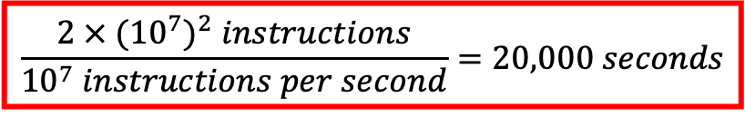
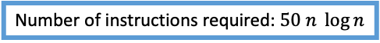
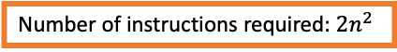
Efficiency
Example scenario: Suppose that two programmers must sort an array of 10 million numbers using two different computers A and B
Computer A
Computer B
Can execute 10 billion instructions per second
Can execute 10 million instructions per second
Programmer 1 used insertion sort
Programmer 2 used merge sort
Number of instructions required: ${2n}^{2}$
Number of instructions required: $50 n \log{n}$
$$\frac{2 × {({10}^{7})}^{2} instructions}{{10}^{7} instructions per second}=20,000 seconds$$
$$\frac{50{ × 10}^{7}\log{{10}^{7}}instructions}{{10}^{7} instructions per second}=1163 seconds$$

Slide 15
Analyzing Algorithms
Analyzing an algorithm has come to mean predicting the resources that the algorithm requires.
Occasionally, resources such as memory, communication bandwidth, or computer hardware are of primary concern, but most often it is computational time that we want to measure

Slide 16
Analyzing Algorithms
In general, the time taken by an algorithm grows with the size of the input, so it is traditional to describe the running time of a program as a function of the size of its input.
The running time of an algorithm on a particular input is the number of operations or steps executed.
Input Size
The best notion for input size depends on the problem being studied
the most natural measure is the number of items in the input

